Slide 1
Unique Filing Status and Exemption Situations
Individuals who are not U.S. Citizens
Pub 4012 – Tab L
Pub 4491 – Lesson 8
Notes:
This is a comprehensive lesson for experienced Counselors and is an important lesson for those districts that encounter a significant number of non-citizens (taxpayers or dependents) at their sites.
New counselors should be aware that special rules may apply to noncitizens and refer affected taxpayers to experienced counselors
Experienced counselors should have a good working knowledge of the special rules. If not, they should decline the return.

Slide 2
Lesson Topics
Resident and nonresident alien defined
Green card test
Substantial presence test
Nonresident alien spouse
Nonresident alien dependent

Slide 3
Resident or Nonresident Defined
Resident alien taxed same as U.S. citizen – on worldwide income (Form 1040)
Nonresident aliens generally taxed on U.S. income only (Form 1040NR out of scope without Foreign Student certification)
Notes:
Must be two certified counselors to prepare Form 1040NR – one to prepare the return and one to review

Slide 4
Alien Defined
Alien any individual who is not a U.S. citizen or U.S. national
Nonresident alien is an alien who has not passed
Green card test or
Substantial presence test

Slide 5
U.S. Citizen Defined
Individual born in United States
Individual whose parent is a U.S. citizen
Former alien who has been naturalized as a U.S. citizen
Individual born in a U.S. Territory

Slide 6
U.S. National Defined
Individual who owes sole allegiance to United States,
including all U.S. citizens and some individuals who are not U.S. citizens
"U.S. National" includes American Samoans or Northern Mariana Islanders who choose not to be U.S. citizens

Slide 7
Resident Alien: Green Card Test
A lawful permanent resident of the United States at any time during calendar year
Has or can get Social Security number
Follow same tax laws as U.S. citizens

Slide 8
Resident Alien: Substantial Presence Test
Pub 4012 Tab L
Physically present, at any time of the day, in United States for minimum number of days over past three years
Test based on formula of days and years individual physically present in the U.S.
Review Resident or Nonresident Alien Decision Chart
Pub 4012 Tab L
Notes:
Class should find chart and read the Steps in the chart

Slide 9
Substantial Presence Test: Exempt Individuals
Pub 519
Special day-counting rules apply for substantial presence test for
Foreign government-related person
Teacher or trainee – J or Q visa
Student – F, J, M, or Q visa
Optional foreign student certification is required
Professional athlete
Notes:
Do not count days present in U.S. for purposes of the substantial presence test for exempt individuals.

Slide 10
Dual Status Individuals
Dual status individuals are out of scope
Year in which change from nonresident to resident (or vice versa) considered dual status individual
File 1040NR for nonresident part of year
File 1040 for resident part of year
Does not apply to a nonresident spouse electing to be taxed as a resident for the full year

Slide 11
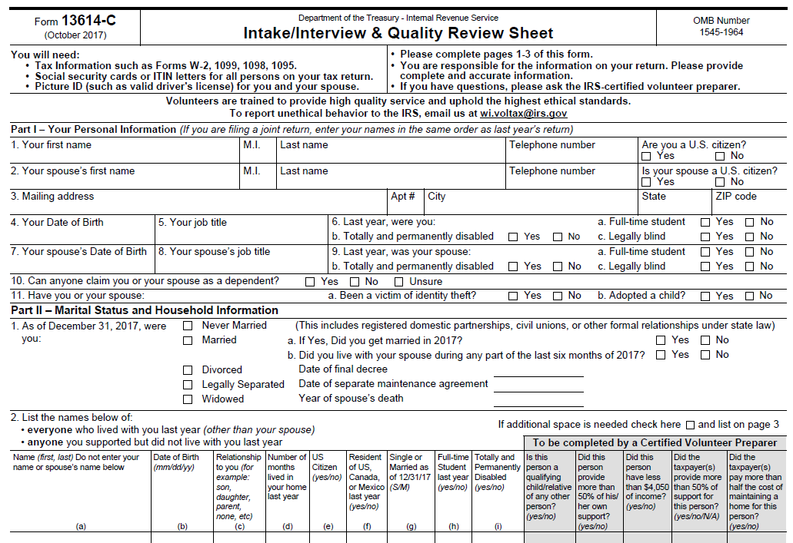
Intake Booklet

Slide 12
Form 1040NR
For sites that prepare Form 1040NR returns for non-resident aliens
Requires two or more volunteers with Foreign Student Certification
Print Form 13614-NR from irs.gov and use it in place of pages 1 and 2 of Tax-Aide Intake Booklet

Slide 13
Nonresident Alien Spouse
Pub 4012 Tab L and Pub 519
Treat spouse as nonresident alien and file HoH or MFS return
Cannot file Single if lawfully married in any country
OR
Election to treat spouse as resident alien on MFJ return and include worldwide income - out of scope
Return in scope if election made in an earlier year

Slide 14
Head of Household Special Rule
If
Taxpayer is U.S. citizen or resident alien for entire year
And
Nonresident spouse chooses not to file MFJ,
Then taxpayer can file as Head of Household
But cannot claim EIC (both taxpayer and spouse must have valid SSNs)
Indicate not eligible for EIC in TaxSlayer
Notes:
If the spouse is a nonresident alien, the “living apart” rule does not apply to the taxpayer

Slide 15
Nonresident Spouse’s Exemption
Exemption deductions are suspended for 2018 – 2025
Spouse is never a dependent so cannot claim Credit for Other Dependents

Slide 16
Claiming a Nonresident Dependent
Nonresident alien stepchild is not a dependent unless child is resident of Canada or Mexico
A resident alien stepchild can be a dependent (if all tests are met)
Dependent must have SSN, ITIN or ATIN
Determine residency status first
Notes:
ITIN – individual taxpayer identification number assigned by IRS
ATIN- adoption taxpayer identification number assigned by IRS

Slide 17
No Child Tax Credit for Nonresident Dependent
Qualifying child for child tax credit must be a U.S. citizen, national or resident
Nonresident dependent living in Canada or Mexico
Select Lived in Canada or Lived in Mexico on dependents page from dropdown – number of months in home
TaxSlayer denies child tax credit (and credit for other dependents)

Slide 18
No Credit for Other Dependent for Nonresident Alien Dependent
Dependent must be a U.S. citizen, national or resident
Dependent must have SSN, ITIN or ATIN
A resident of Canada or Mexico?
Can be a dependent (e.g. for medical expense deduction)
Cannot get child tax credit or credit for other dependent

Slide 19
Claiming an Adopted Dependent
Adopted nonresident alien child is a dependent if lived with taxpayer entire year
Adopted dependent must have SSN, ITIN or ATIN by due date of return according to rules for U.S. citizen taxpayers

Slide 20
EIC with Nonresident Spouse
Both taxpayer and spouse must be citizens or residents for entire year (even if filing HoH)
Check if spouse nonresident alien during the year in personal information section
Can claim EIC if spouse elects to be taxed as a resident
Taxpayer, spouse and claimed dependents must have SSNs
Notes:
Taxpayer, spouse and qualifying child dependents must have social security numbers by the due date of the return to claim EIC
If filing HoH, question regarding nonresident alien spouse does not come up in Personal Info in TSO. Instead, need to go to the Due Diligence Checklist and the question is worded slightly differently.

Slide 21
Quality Review
If electing MFJ with nonresident spouse, verify written declaration made in prior year is attached
Current year election out of scope
If MFJ, verify worldwide income included and correctly converted to U.S. dollars
No EIC claimed, unless filing MFJ and everyone being claimed for EIC has valid SSN – including taxpayer and spouse

Slide 22
Unique Filing Status
Questions?
Comments?

